Slide 1
JAVA MEMORY MANAGEMENT PART-2 Garbage Collection
Presenter: Davoud Badamchi
Presentation Date: 6/04/2019 10:00 am

Slide 2
In this session
Will understand how garbage collector works. So, you’ll right efficient code to prevent memory leaks.
You will learn how to monitor Java applications’ memory usage and see the effectiveness of garbage collection to prevent and detect potential memory leaks.

Slide 3
Stack & heap
When variables are eligible for garbage collection?
The stack is very efficient, Java can manage it very easily.
When one closing curly bracket reaches the variables of corresponding code block will be popped off from the stack.
What is the problem of stack?
Scope of stack is so tight. It is based on code blocks.
Sometimes we want to live objects for longer period of time than their closing scope.
What if we want to share objects with other objects.

Slide 4
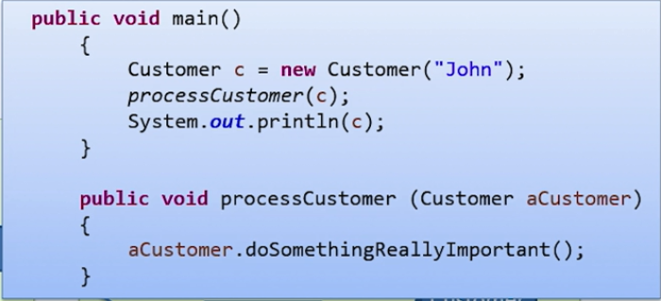
Stack & heap
If Customer object stay in stack after finishing first method’s scope, it won’t be reached in second method.
Here the role of the heap comes into play.
Lifetime of objects on the heap are very variable.

Slide 5
Stack & heap
In programming languages like C, C++, VB or Pascal you have the choice whether to store objects in stack or heap. Because of keeping simplicity, Java didn’t do this.
Not to mention, modern JVMs are very clever and efficient and if they detect that object won’t be shared outside of code block it’ll store in stack.

Slide 6
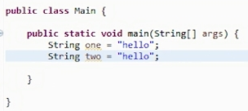
String pool & internalized string
How it’ll look like below snippet in memory?
After creating first string in heap the second will refer to the same string object in heap.
Please care to check string variables’ equality with .equal() method
== operator is used to check reference equality
.equal() method checks value equality

Slide 7
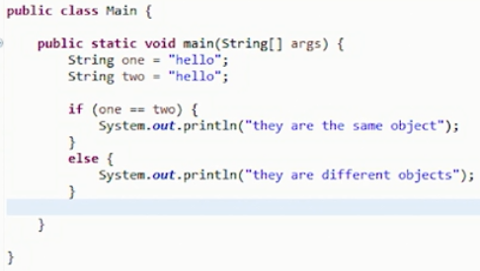
String pool & internalized string
What is the result of below code?
Result:
They are the same object
We have created two string but one in reality. JVM puts strings in String pool and use them where ever it can.

Slide 8
String pool & internalized string
String stores in string pool if you define them in a simple way.
How about the result of this code?
String three = new Integer(76).toString();
String four = “76”;
If (three == four){
System.out.println(“They are the same objects.”)
}else
System.out.println(“They are different objects.”)
What should we do if we want to put this string too string pool too?
Result:
They are different objects

Slide 9
String pool & internalized string
Using .intern() method.
String three = new Integer(76).toString().intern();
String four = “76”;
If (three == four){
System.out.println(“They are the same objects.”)
}else
System.out.println(“They are different objects.”)
By using .intern() method “76” will insert into string pool for reusability.
Thus, it is better to store all the strings in string pool because it decreases not the number of objects in heap, but also need for garbage collection.
Result:
They are the same object

Slide 10

Garbage Collection & Memory leak
One difference between Java and other languages is Java do garbage collection automatically.
C language collect objects by calling free() method explicitly.
In VB you have to set the object to null to clear the reference of the object
What is memory leak?
If the programming language do not clear unused objects manually or automatically, they’ll reside in the Heap and memory leak will happen. Even closing the program won’t clean the memory. The only solution for this problem is just restarting the computer.

Slide 11
Memory leak – effects & example
Effect of memory leak:
Slow system performance
Faults or crashes in running programs
The system may hang
Example: pseudo code for withdrawing money from ATM with memory leak
Enter Amount
Get some memory
If ((Amount > Account balance) or (transaction == canceled) ) {finish}
Else {
Debit the account with the amount
Dispense the cash
Release the memory for the remembered amount
}
This code has memory leak and finally will eat all the memory and the host computer have to be restarted. The same will happen if the faulty program runs again.

Slide 12
Memory leak
Example: pseudo code for withdrawing money from ATM without memory leak
Solution:
Enter Amount
Get some memory
If ((Amount > Account balance) or (transaction == canceled) ) {finish}
Else {
Debit the account with the amount
Dispense the cash
}
Release the memory for the remembered amount

Slide 13
Memory leak
Java avoids memory leaks in two way
1. When a “new” keyword is used to create an object JVM itself gives memory not Operating System. JVM is written in C and underneath it gets the memory and call .free() method when it needed.
2. Using Garbage Collector.
GC is invented in 1959 in Lisp language, What Java did was dispersing the concept.
Memory leak can happen because of programmers mistake. We call them soft leaks.
They are hard to detect.
Question: We said Java avoids memory leaks from happening by Automatic GC, Why GC cannot prevent soft leaks?
Because there are references to that object from Stack.

Slide 14
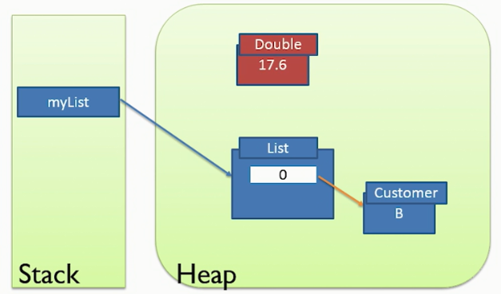
Garbage Collection
Any object that cannot be reached from stack are eligible for Garbage collection.
Object “Double” will be collected at some point in the future.

Slide 15
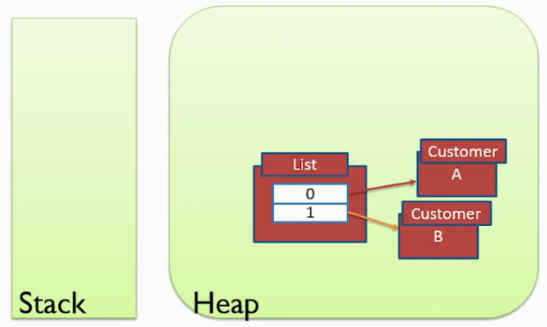
Garbage Collection
Here all objects are garbage. Even CustomerA and CustomerB which have reference to them from List object. Because List object is unreachable from stack.

Slide 16
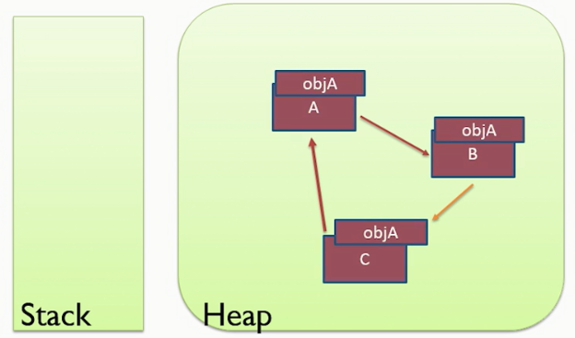
Garbage Collection
Here all objects are garbage. Because non of the objects are reachable from the stack.
JAVA controls all of this automatically and we as a programmer do not have any concern and responsibility.

Slide 17
.gc() method
We can run GC(Garbage Collector) manually but there is no guarantee JVM do garbage collection.
It isn’t good idea to run .gc() manually.
Before starting GC all threads in application halt and garbage collection do its job. So we want GC to be very quick and infrequent. As a result, forcing to run .gc() isn’t good ideia.
How to call Garbage Collection manually?
Runtime.getRuntime().gc() or System.gc()
Class demonstration for manually calling the .gc() method.
We can use .gc() method to examine our code to see if it is written in efficient way or not.

Slide 18
.gc() method example
public static void main(String[] args)
{ Runtime runtime = Runtime.getRuntime();
System.gc();
long availableBytes = runtime.freeMemory();
System.out.println("Available memory: " + (availableBytes / 1024)/1024 + "MB");
Thread t;
for (double i=0; i<10000000L; i++) t = new Thread();
availableBytes = runtime.freeMemory();
System.out.println("Available memory: " + (availableBytes / 1024)/1024 + "MB");
System.gc();
availableBytes = runtime.freeMemory();
System.out.println("Available memory: " + (availableBytes / 1024)/1024 + "MB");
}

Slide 19
.finalize() method
finalize() method is a method inside the Object class.
Finalize method called when garbage collector determines there are no references to the object.
Because we don’t know whether JVM will run Garbage Collector or not, we cannot rely on initialize method to do things like closing I/O or Database connection resources.
.finalize() method is deprecated since JDK 9, it is still available in JDK 12 and not removed.

Slide 20
VisualVM tool
VisualVM is a tool that provides a visual interface for viewing detailed information about Java applications while they are running on a Java Virtual Machine.
It’s been removed from JDK 12 and you have to download and use it as a supplementary tool beside JDK 12.
Class demonstration of VisualVM tool and its usage.
Watching the heap memory while memory leak happens.
Solving the existing application’s leaking problem and seeing how memory looks.

Slide 21
Garbage collection
General algorithm for garbage collection is “Mark and Sweep”.
Modern garbage collectors search for objects that must be retained on heap.
There are two stages: first is Marking, and second is Sweeping.
In the marking stage first program’s execution pauses all the threads which is called “stop the world event” then GC starts marking all the objects that have reference from the stack.
Sweeping starts and removes all the unmarked objects from the Heap.
After freeing up the memory all the marked objects are moved to the contiguous part of memory to prevent fragmentation, the reason is for quicker finding the objects for future use.

Slide 22
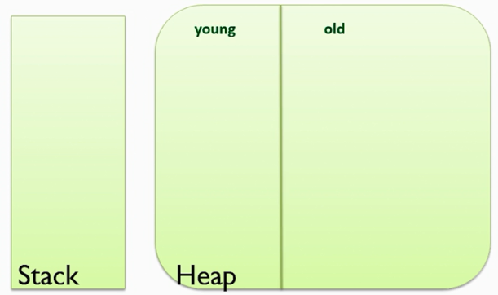
Generational Garbage collection
If our program have tons of referenced objects on Heap marking all those objects will take much longer time and user will notice the frozen of the application, so here come the Generational GC concept into play.
Heap divides into two section.
Young and Old generation.
Young generation is smaller.

Slide 23
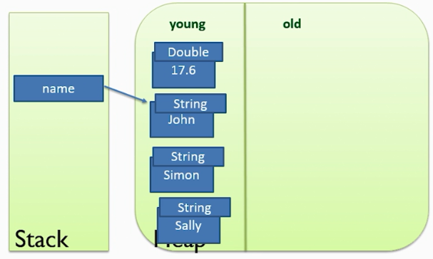
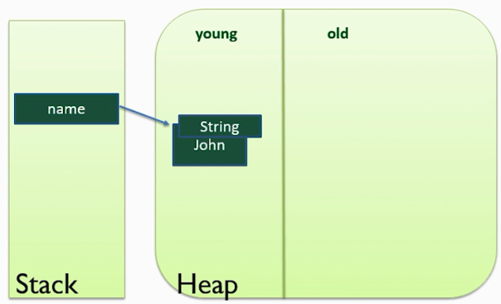
Generational Garbage collection
New objects are created in young generation.
Because it is small it won’t take too long for garbage collection.
1. Before Garbage collection
2. After Garbage collection

Slide 24
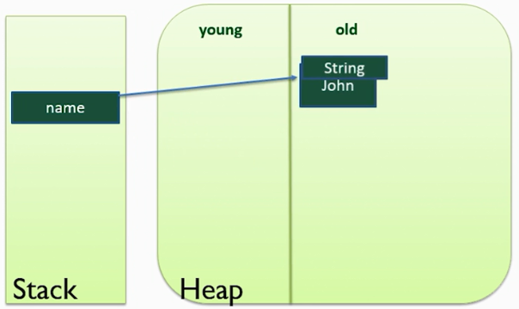
Generational Garbage collection
After GC all the survived objects are copied to old generation.
The GC of the young generation is known as Minor collection.
The GC of the Old generation is called Major collection.

Slide 25
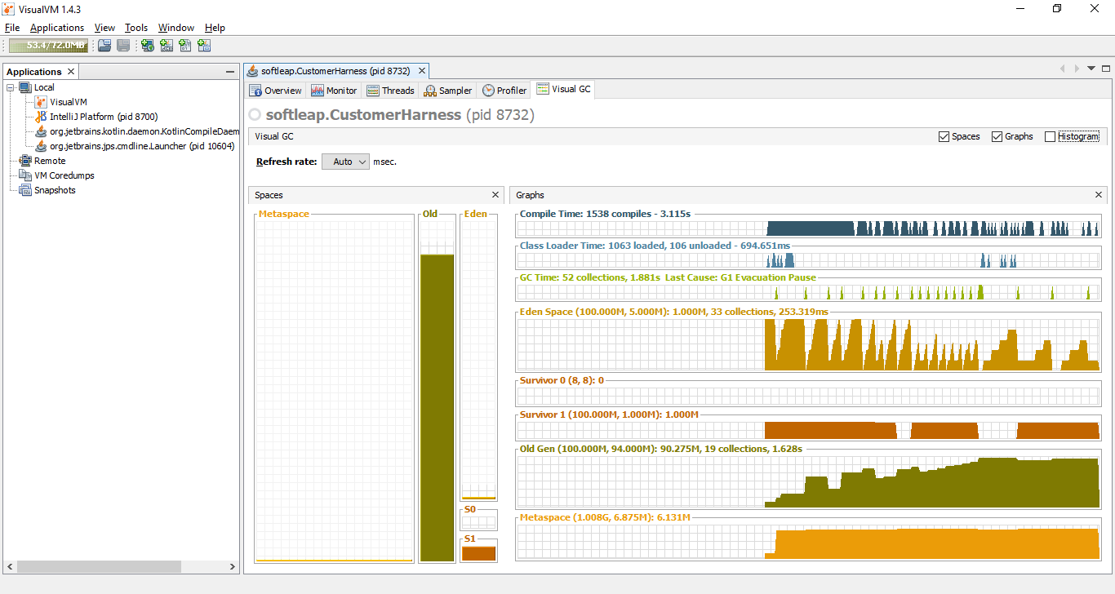
Visual GC plugin
Seeing Old and Young generation in VisualVM tool with Visual GC plugin.

Slide 26
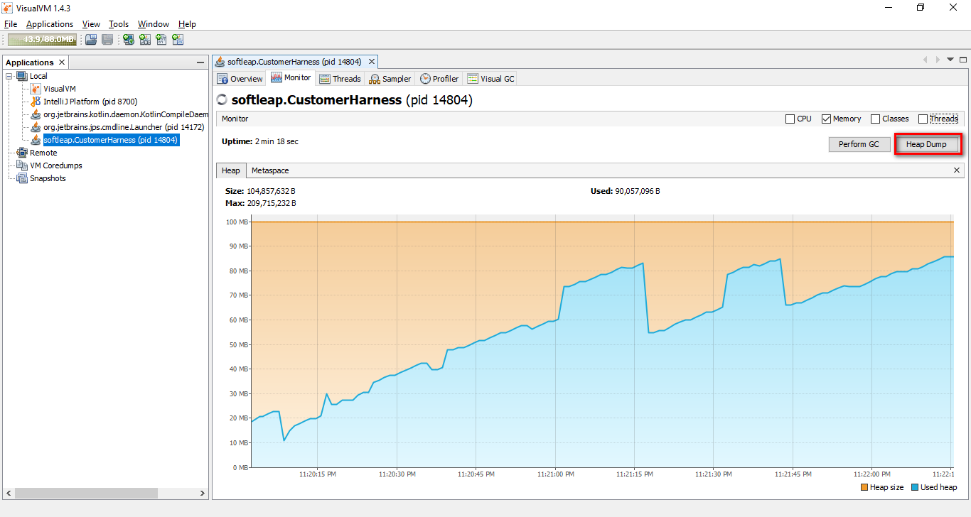
Memory Analyzer tool
With the help of memory analyzer we can detect where the leak happens in the code.
First we take dump from memory.

Slide 27
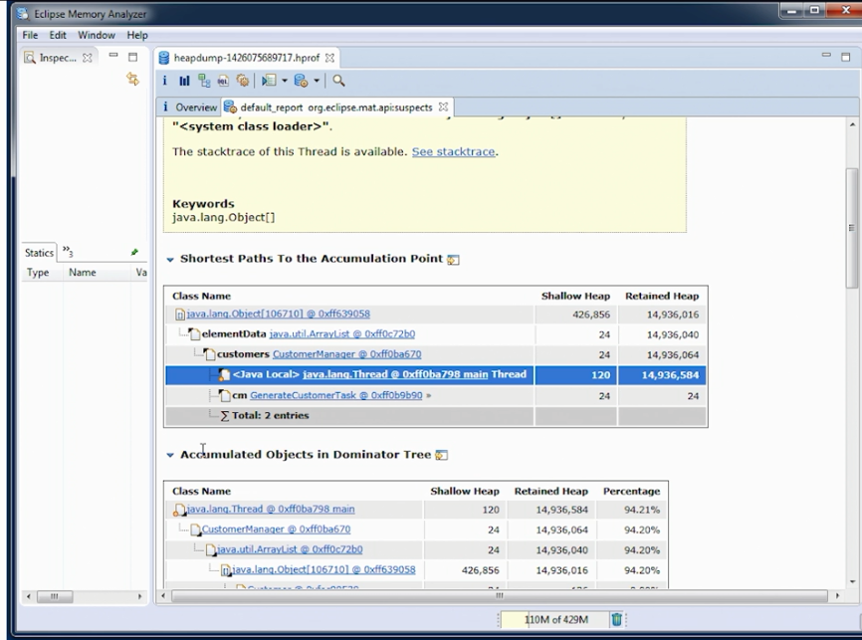
Memory Analyzer tool

